Slide 1
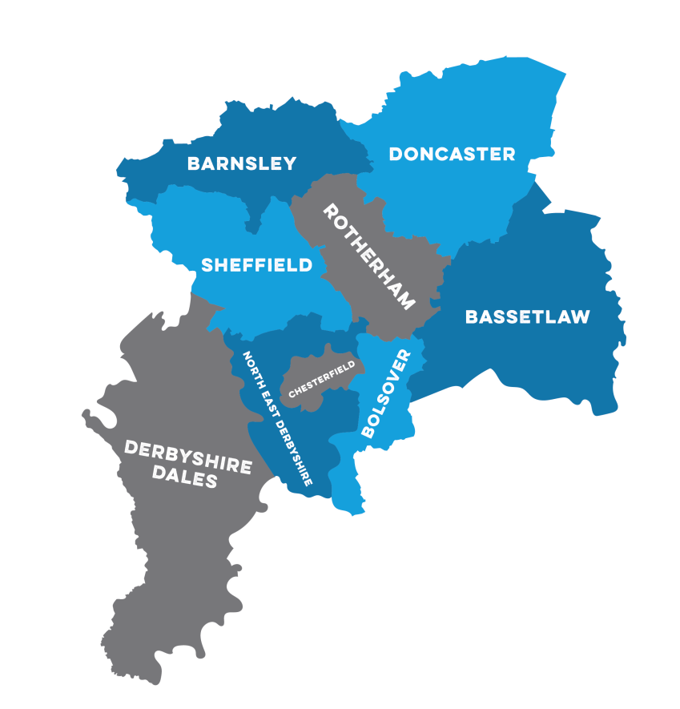
About us
Higher Education Progression Partnership
Hepp and HeppSY work together to ensure that learners in our region know what higher education is, and that it is an option for them
We are here to provide impartial information about higher education and gaining higher level skills to help you make an informed choice about your futures

Slide 2









Sixth form
Higher Education Institution
School
College
Work
Routes Through Education
Notes:
Brief overview of options – explain we will start with Further Education
Give an overview of your education journey and student ambassadors- can be here or in the Higher education section

Slide 3
Sixth form
Further Education
Post-16
Still compulsory but you can choose where to study
More subject choices
More practical/ vocational choices – different places will offer different courses
Apprenticeships enable you to work and study
School
College
Notes:
*Animations automatic – one click to make text box disappear, then click for next slide
After school, you can choose which further education is best suited to you.
There are more options than at GCSE, so it is worth exploring what is available to you in your area.
It is also worth considering if you want to go to university, as certain university courses will have certain requirements (e.g. to study biology at University you need to have a biology A Level or equivalent, at a certain grade).

Slide 4
What qualifications can you choose after Year 11?
Year 10 and Year 11
GCSEs
A Levels
‘Vocational’ courses, such as BTEC
Apprenticeship
T levels
Notes:
Ask group for their ideas
So what are your options after year 11? During year 10 and 11 you will study your GCSE subjects.
After year 11 everyone has to stay in some form of learning, but this doesn’t have to be full time.

Slide 5
A Levels
Vocational e.g. BTEC, Cambridge
2 year course assessed via exams- studied at sixth form or college
Choose 3-4 subjects
Some institutions allow you to combine A levels and other qualifications e.g. BTECs
Combination of course work and exam assessment
Different qualification names e.g. BTEC
May be combined with other types of qualification depending on the institution
T Levels
Apprenticeships
Mixture of technical knowledge and practical skills
Industry placement of at least 45 days
Assessed through exam and project work
Available at Level 3 (Need 5 GCSE’s at grade 4+)
GCSE grades- often grade 4 in Maths and English, may require Science
Job areas and amount of vacancies available will vary
Combination of work and studying
Notes:
Take out some text / simplify

Slide 6
Where will you study?
Notes:
Hide the following area slides as needed, brief overview of local area
Encourage students to research and find out what courses they offer

Slide 7
Rotherham
Notes:
Hide as needed
Notes if needed
RNN - 3 sites / offers vocational courses
TRC – vocational and A-Levels
6th forms – mixture of courses
Students need to research and check

Slide 8
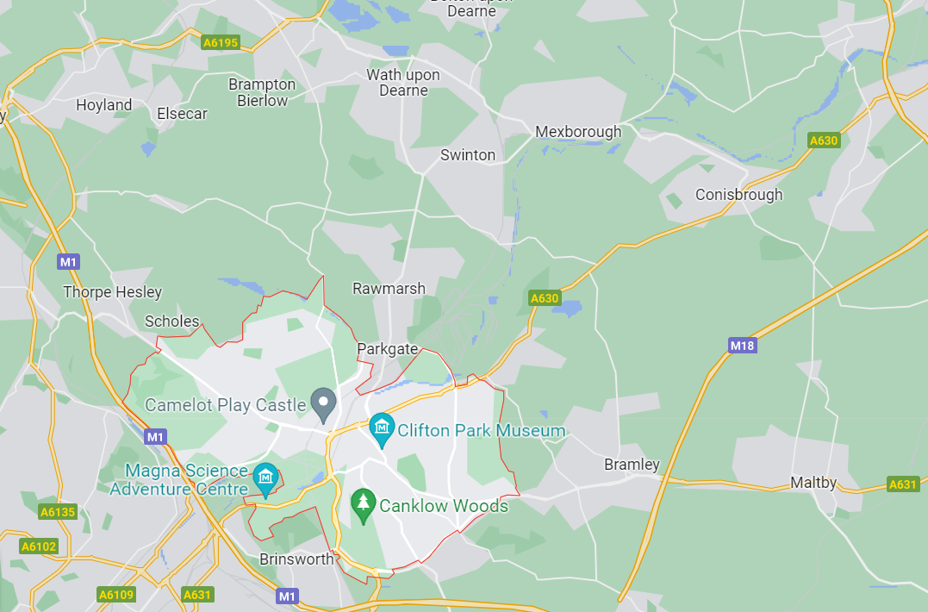

Brinsworth Academy
Wath Academy
RNN
Maltby Academy
Aston Academy
Swinton Academy
Wickersley
Thomas Rotherham College

Slide 9
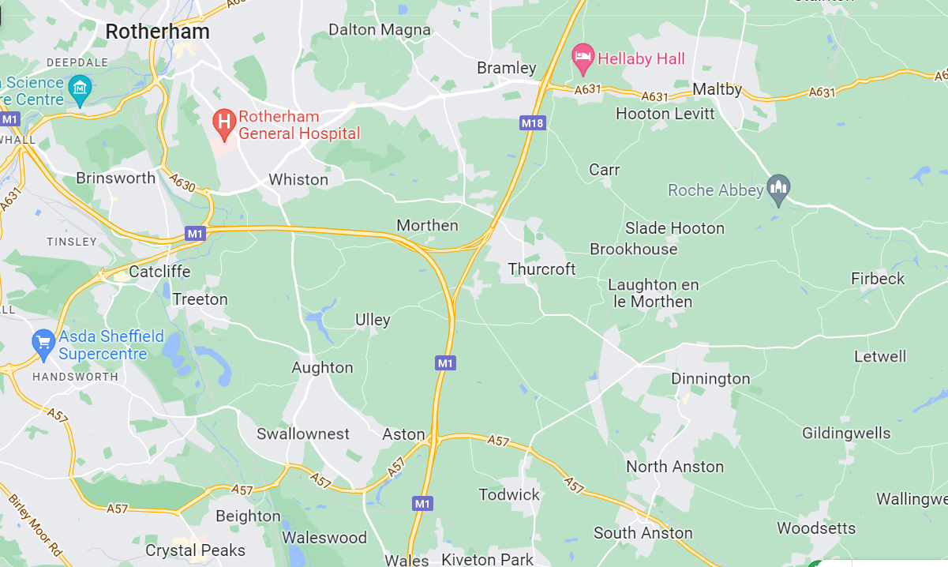
Wales High School
Aston Academy
Dinnington Academy

Slide 10
Higher Education

Slide 11
Sixth form
Higher Education Institution
School
College
Higher Education
Post-18
Over 300 providers in the UK
Approximately 35,000 courses to choose from
Stay home or move away
Notes:
*Animations automatic – one click to make text box disappear, then click for next slide

Slide 12
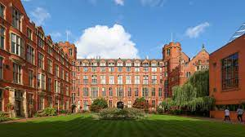
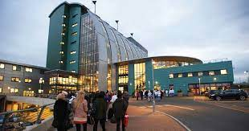
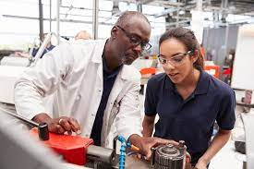
What is higher education?
Higher education is when you work towards getting a qualification post-18-years-old.
Qualifications can be gained from:
University
Certain Colleges
Degree Apprenticeships
Higher education is there for everyone!
Notes:
Intro – next slides to explain
Higher education is when you work towards getting a qualification after you turn 18
You may need to explain/ask the class to suggest what a qualification is. Mention that a Degree is a type of qualification before revealing where qualifications can be gained from. You could discuss GCSEs being types of qualification.
You can get higher education qualifications from university (e.g. The University of Sheffield or Sheffield Hallam University), certain colleges (e.g. Sheffield, Rotherham, Barnsley, Doncaster colleges), or degree apprenticeships (earn while you learn). When you successfully complete the course, you are called a graduate.
This a good time to talk about higher education being an option for everyone and that there being support available no matter what your circumstances.
- Lots of ways to do it ('you can find an option that suits you')
- Lots of different courses with different entry requirements ('you don't have to be super smart'/'people of different abilities can go')
- Lots of financial & pastoral support ('it's not just for people who are rich/posh/from a certain area or who know people who've gone to HE', there is also support for people with additional needs such as having a mental/physical/learning disability or coming from a situation of being in care or being a carer)

Slide 13
Sixth form
Higher Education Institution
School
Work
Some jobs require a degree
Can also work and study simultaneously by doing an apprenticeship (Advanced, Higher or Degree)
College
Work
Notes:
*Animations automatic – one click to make text box disappear, then click for next slide

Slide 14

Action step ideas
Speak to your career advisors or contact our HEPAs
Do some research – research HE courses and what qualifications and grades they require for entry
Speak to your family and ask them about their education and career journeys
Keep hold of your answers so when the time comes, you know what to ask yourself to make a good decision
Go to open evenings for sixth forms and colleges
Notes:
Change to ideas of things they could add to their action steps.
Change style from bullet points

