Slide 1
Notes:
My name is ‘insert name’ and I’m here today on behalf of the Department for Education to talk to you about apprenticeships.
Apprenticeships are one of the many fantastic options available to you when you leave school/college/sixth form and are becoming increasingly popular with students who are looking at their next steps after school/college and are eager to jump straight into the world of work and get earning and learning.
Suggested interaction: Some of you may already have heard of or know a little bit about apprenticeships, or you may know a friend/family member who did an apprenticeship, so before I get started, really quickly I’m going to ask you by a show of hands/using a quick poll:
Who feels confident that they know what an apprenticeship is? Raise your hand/complete the poll to indicate if you know a little bit / a lot / nothing about apprenticeships. (This is to capture impact).
Keep your hand raised if you feel like you roughly know where to look for apprenticeships and how to go about applying for them.
Lastly, is anyone already looking into apprenticeships or considering them as an option?
Excellent, well hopefully by the end of today’s session, you’ll all have a better understanding of:
What apprenticeships are
The range of apprenticeship job roles available
The different levels
How you find an apprenticeship and
What you need to do next to start searching and applying
It’s really important to keep your options open about your future. There are lots of new and exciting programmes, courses, training options and routes to help you to achieve the career that you would like, or to explore future careers you may not know existed, all in a learning style and environment that suits you. It’s important to consider lots of different options so that if your plans change, you still have lots of exciting opportunities open to you.
So even if you already have a Plan A and Plan B, I would encourage you to listen carefully for the next 15 minutes or so and to ask lots of questions so that I can help you to explore how amazing apprenticeships are and whether they might be the right option for you.

Slide 2
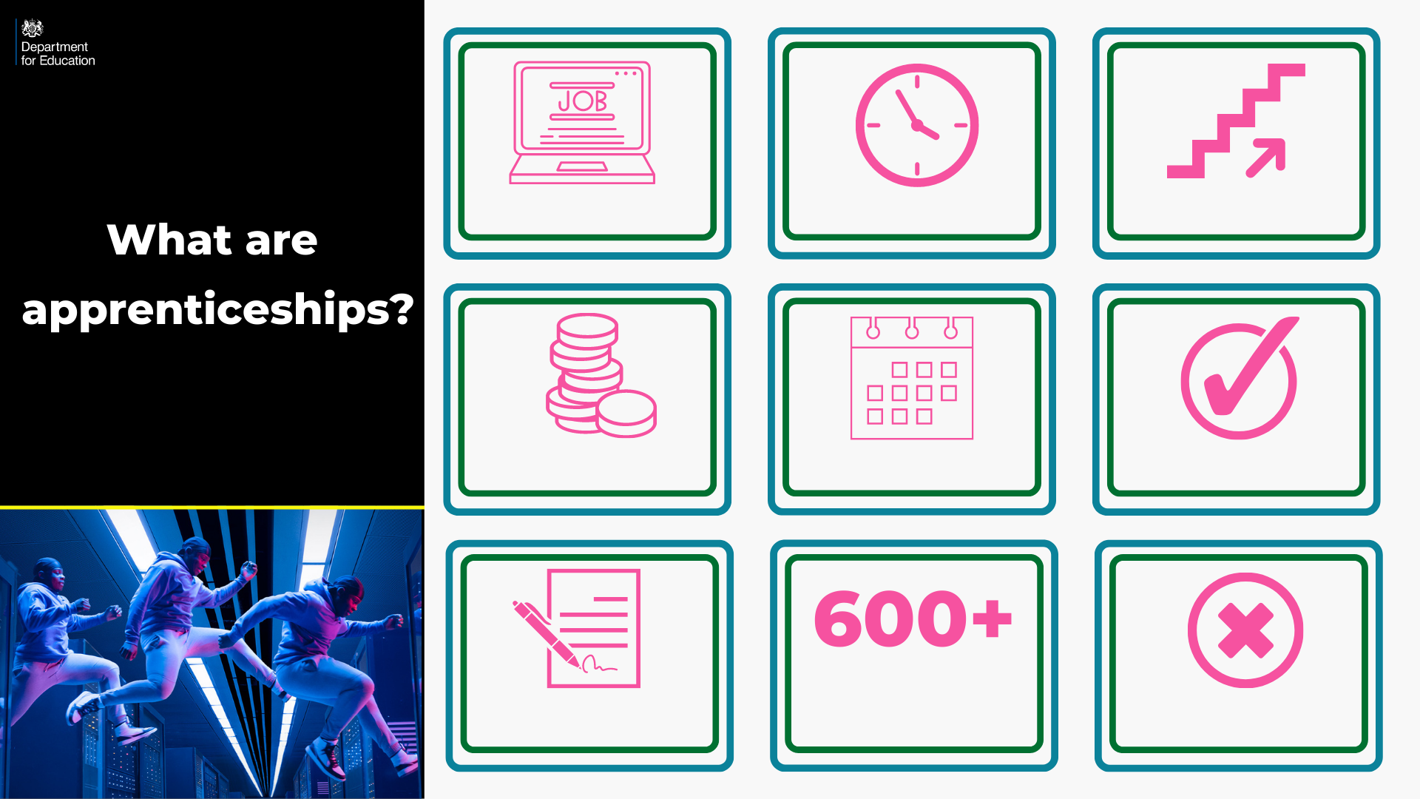
Employed
Off the job
Intermediate – degree level
Paid a salary
Typically 1-6 years
Real responsibilities
600+ standards
Contract
Not the easy option
Notes:
So what is an apprenticeship?
An apprenticeship is a real job, with a real employer, where the apprentice will work full-time whilst also studying towards a qualification.
So you could be an apprentice working for Sky as a journalist, for example, whilst also studying and gaining a qualification in journalism.
PAID A SALARY
As it’s a real job, you will earn a wage – and it can be a really good salary too! The salary of an apprentice can vary from employer to employer. Legally, an employer must pay an apprentice the National Minimum Wage for apprentices, which is currently £4.81 per hour. This is lower than the normal National Minimum Wage, but it recognises that some people will be going into their first job with little or no experience.
The good news is that lots of employers pay a lot more than the National Minimum Wage for apprentices, with some local employers offering starting salaries of £xx,xxx and other national employers even offering starting salaries over £15,000-£20,000.
I have pulled together some local vacancy information which I will show you in a little while, so you can see some real examples of local and national apprenticeships available and see what types of salaries are being offered.
It’s important to remember that if you see an apprenticeship you’re interested in, don’t be put off by the pay if it’s low: there’s room for progression and working your way to the top of an organisation.
CONTRACT
You will also get a contract of employment, holiday pay, annual leave etc – exactly the same as any other member of staff.
STUDY AND WORK
The apprentice will spend the majority of their time ‘on-the-job’ (doing their role), and a minimum of at least 6 hours per week ‘off-the-job’, which means studying or working towards their qualification.
This study element (off-the-job) would take place with a training provider, who will help them to achieve the qualifications and make sure they complete their apprenticeship.
Training providers could be colleges, Universities or independent training provider organisations, who deliver the training/teaching element of the course.
The employer will also support the apprentice, helping an apprentice to gain qualifications and valuable new skills and experience. As well as their time, employers also pay the fees of the apprentice’s training, showing their investment in the apprentices development.
TYPICALLY 1 – 6 YEARS
An apprenticeship typically takes 1 to 4 years to complete (sometimes up to 6 for some areas like a Solicitor). As a minimum, all apprenticeships must last for a minimum of 12 months.
The total duration will depend on the delivery model that the employer selects (how the mixture of training and working is delivered), the level (which we will come onto explain) and the subject they are studying.
600+ STANDARDS and INTERMEDIATE – DEGREE LEVEL
There are more than 600 different apprenticeship standards covering many different levels of apprenticeships, from Level 2 (which is the equivalent of 5 GCSEs), all the way up to Level 7, which is the equivalent to masters level. So you can actually work your way towards gaining a degree or masters through an apprenticeship. We will discuss this more shortly.
REAL JOB = RESPONSIBILITIES and NOT THE EASY OPTION
As I said before, it’s a real job and so it’s important to remember that apprenticeships aren’t the ‘easy option’. Holding down a full time job and studying takes a certain skill and commitment, and it won’t be right for everyone.

Slide 3

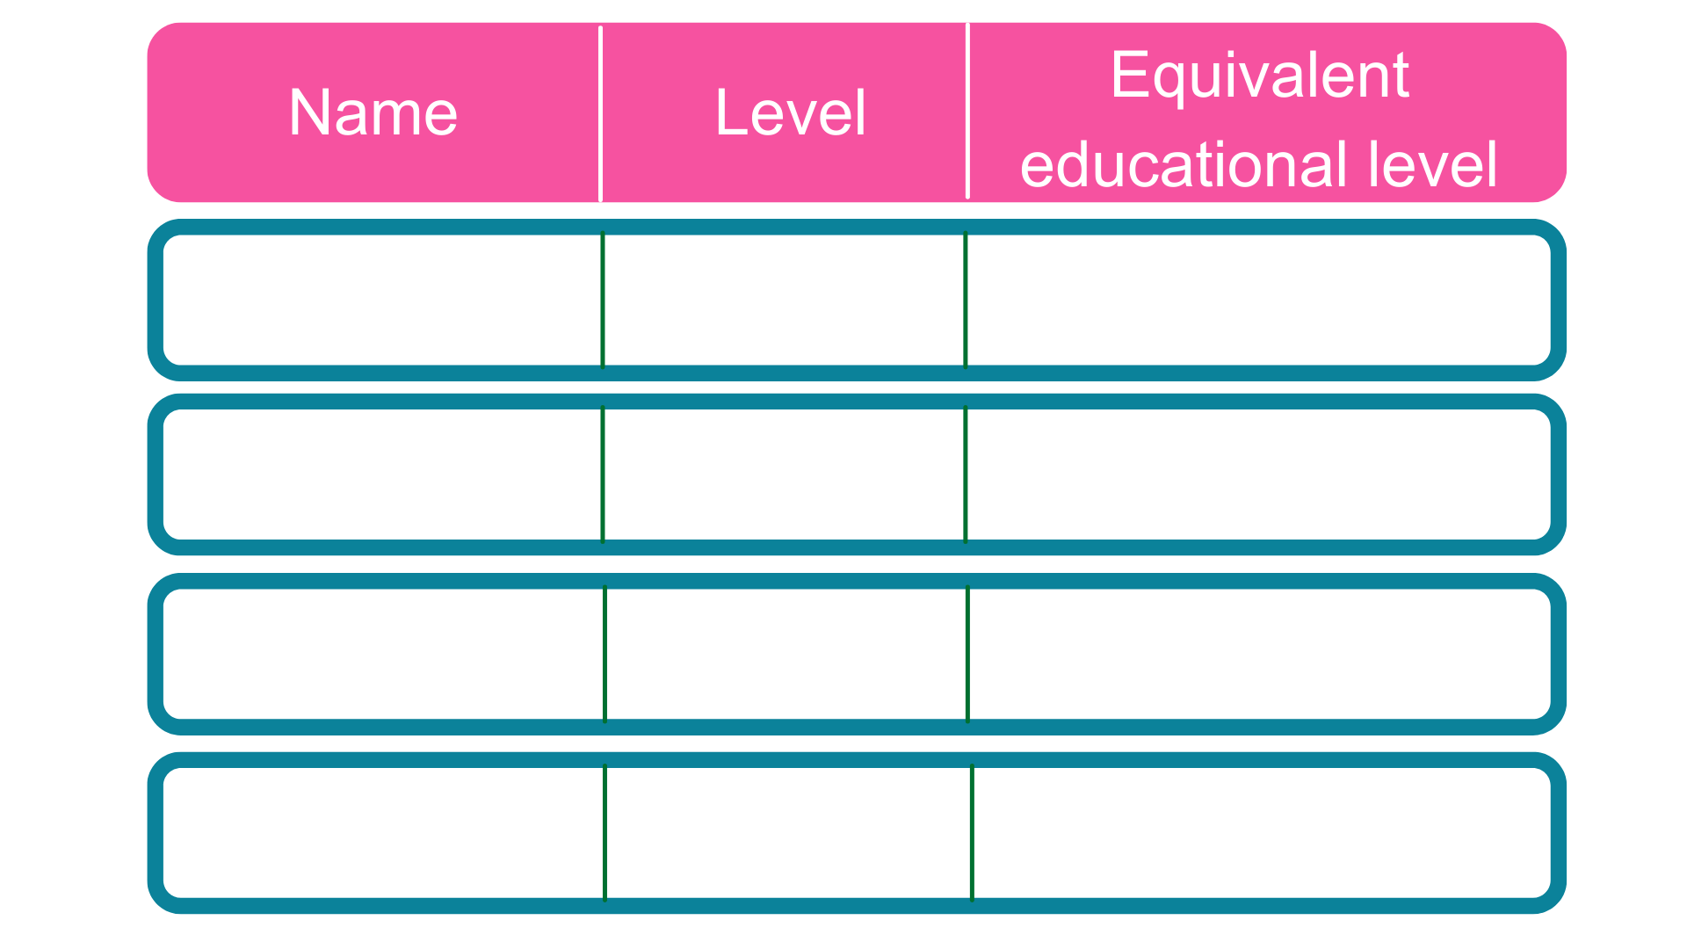
Intermediate
5 GCSE passes at grade A*-C or 4-9
2
2 A Levels / Level 3 diploma / international Baccalaureate
3
Advanced
Higher
Foundation degree and above
4,5,6 & 7
Degree
Bachelor’s or master’s degree
6 & 7
Notes:
Each apprenticeship has a level which will fall into one of the four categories above: Intermediate apprenticeships, Advanced apprenticeships, Higher apprenticeships and Degree apprenticeships.
The equivalent educational level column helps to explain what level the qualification at the end of the apprenticeship will be in comparison to more familiar qualifications, like GCSEs and A Levels.
So you can see that if you do a level 3 (advanced) apprenticeship, once you have qualified you’ll have gained a qualification that is equivalent to 2 A Levels, a level 3 diploma or other equivalents, like IB’s or BTECs.
Presenter notes: Opportunity to pause to ask if there are any questions about levels and how they work.
The level of apprenticeship you start at will depend on the kind of job that you are applying for.
It’s really important not to be held back by only looking for a particular level e.g. degree apprenticeships. Apprenticeships work a bit differently to school which can be confusing, as lots of students think that they should progress onto the next level, so if you leave after GCSEs you should do a Level 3 and if you finish after A Levels you should go for a degree apprenticeship, but this isn’t always the case.
Depending on the sector and apprenticeship, it may be that you need to start at advanced or higher level and work your way up, or that brilliant apprenticeships are only offered at Level 2 or 3 – for example, Journalism is only offered at Level 3 because that is all the industry requires.
Equally, you may be entering a completely new sector or industry that you haven’t studied or worked in before, and so may need to do a Level 2 or 3 to enter the world of work and get that understanding. Doing a job is completely different to getting a GCSE or A Level and that’s why it can be a bit confusing.
It is very important to keep an open mind so that you can explore all of the opportunities available and have multiple options available when applying.

Slide 4


Notes:
Suggested interactivity: Run this next section as a quiz / movement session if possible. Students can either:
Raise/lower hands for face to face and virtual
Access their phones for Kahoot quiz (if possible)
Move to different sides of the room (if possible)
Use the existing quiz on Amazing Apprenticeships - https://amazingapprenticeships.com/apprenticeships-quiz/
Or engage with an apprentice ambassador regarding these questions (if possible)
Please plan accordingly based on the audience size, engagement levels, accessibility needs, time of the session and space provided. See interactivity slides for suggestions.
I’m now going to ask for your help for a short activity, to get us all moving around.
There are lots of myths about apprenticeships that can make them quite confusing and so we’re very quickly going to go through some of these. I’d like you to listen/read the statement and indicate whether you believe it is a truth or a myth about apprenticeships by raising/lowering your hand, standing on the left/right side of the room, scanning the QR code/clicking the link to the quiz here.
So, statement 1:
‘EMPLOYERS DON’T OFFER JOBS TO APPRENTICES ONCE THEY HAVE COMPLETED THEIR APPRENTICESHIP’ – truth or myth?
This isn’t true – the answer is myth. The majority of apprentices (around 90%) stay in employment after their apprenticeship. If they do change companies, it’s usually because they’re able to compete for a better job, perhaps with more pay or more responsibility.
It’s also important to remember that the employer has invested both their time and money in training you and developing your skills for the job, and so they are going to want to keep that skillset within their company.
Statement 2:
‘APPRENTICES WON’T GET TO HAVE FUN OR MEET OTHER YOUNG PEOPLE’
Lots of young people are worried that as an apprentice you won’t get to have fun or meet other young people. That isn’t true.
Depending on the size of the company, you may find yourself working with lots of other young people, or you may meet them through your apprenticeship training. Lots of employers and training providers try to offer ways for apprentices to connect with each other, through social events, team activities, networks and other support.
Some bigger employers, for example, have helped their apprentices who are re-locating for work to link up with other apprentices who are re-locating and find shared accommodation.
You can also join a number of different apprentice networks, including the Apprenticeship Ambassadors programme, where you will meet and connect with hundreds of other apprentices.
Statement 3:
‘APPRENTICESHIPS ARE ONLY FOR PEOPLE THAT DON’T GO TO FULL-TIME UNIVERSITY’
Another myth is that apprenticeships are only for people that don’t go on to full time uni. That’s not true. Through degree apprenticeships, apprentices can still now earn their degree, just in a different way. Apprenticeships are for everyone, from those just leaving school, those changing careers or those wanting to learn new skills.
Statement 4:
‘APPRENTICES DO SO MUCH MORE THAN MAKING TEA’
This is very true!
Apprentices are doing real jobs across a variety of sectors and are having a huge impact on projects across the country, whether that’s researching cures for diseases, developing the latest flag-line technology in sports, reporting on breaking news or working in our emergency services, apprentices are certainly not making the tea.
Statement 5:
‘APPRENTICESHIPS ARE THE EASY ROUTE’
Some people think that apprenticeships are the easy route, but this is not the case. Apprentices are balancing a full-time job and studying (which can be up to degree level) at the same time. They are learning and adapting in a new working environment and contributing to real-life work projects and tasks, which comes with responsibility, whilst ultimately working towards their end point assessment and achieving their apprenticeship.
Suggested interactivity: Ask any students who answered apprenticeships were the easy route why this was their answer. Facilitate discussion around this.
Statement 6:
‘APPRENTICESHIPS ARE LIKE UNIVERSITY IN THAT I CAN GO ANYWHERE IN THE COUNTRY’
This is true.
One of the best things about apprenticeships is that they are everywhere. So if you want to carry on living at home then you can, but you can sometimes move around the country with an apprenticeship. It’s really important to do your research – but some companies will help you to relocate to work for them. Others will support you in other ways, like finding other apprentices to live with or sharing information about the local area to make the move easier. But there are lots of opportunities.
Suggested interactivity: The presenter could now ask the group if they had any questions or heard any other myths about apprenticeships that they’d like to ask.
Thank you for your involvement in that, that was really interesting and hopefully a helpful discussion for you.
Presenter notes: Please feel free to add in any other statements to extend the game and to answer common questions you may be getting asked by students.

Slide 5
Employers like to keep on apprentices who do well
You can meet other young people and have fun
Apprenticeships aren’t just for people that don’t go to full time uni
Apprentices do much more than making tea
Apprenticeships are NOT the easy route
Notes:
Suggested interactivity: Run this next section as a quiz / movement session if possible. Students can either:
Raise/lower hands for face to face and virtual
Access their phones for Kahoot quiz (if possible)
Move to different sides of the room (if possible)
Use the existing quiz on Amazing Apprenticeships - https://amazingapprenticeships.com/apprenticeships-quiz/
Or engage with an apprentice ambassador regarding these questions (if possible)
Please plan accordingly based on the audience size, engagement levels, accessibility needs, time of the session and space provided. See interactivity slides for suggestions.
I’m now going to ask for your help for a short activity, to get us all moving around.
There are lots of myths about apprenticeships that can make them quite confusing and so we’re very quickly going to go through some of these. I’d like you to listen/read the statement and indicate whether you believe it is a truth or a myth about apprenticeships by raising/lowering your hand, standing on the left/right side of the room, scanning the QR code/clicking the link to the quiz here.
So, statement 1:
‘EMPLOYERS DON’T OFFER JOBS TO APPRENTICES ONCE THEY HAVE COMPLETED THEIR APPRENTICESHIP’ – truth or myth?
This isn’t true – the answer is myth. The majority of apprentices (around 90%) stay in employment after their apprenticeship. If they do change companies, it’s usually because they’re able to compete for a better job, perhaps with more pay or more responsibility.
It’s also important to remember that the employer has invested both their time and money in training you and developing your skills for the job, and so they are going to want to keep that skillset within their company.
Statement 2:
‘APPRENTICES WON’T GET TO HAVE FUN OR MEET OTHER YOUNG PEOPLE’
Lots of young people are worried that as an apprentice you won’t get to have fun or meet other young people. That isn’t true.
Depending on the size of the company, you may find yourself working with lots of other young people, or you may meet them through your apprenticeship training. Lots of employers and training providers try to offer ways for apprentices to connect with each other, through social events, team activities, networks and other support.
Some bigger employers, for example, have helped their apprentices who are re-locating for work to link up with other apprentices who are re-locating and find shared accommodation.
You can also join a number of different apprentice networks, including the Apprenticeship Ambassadors programme, where you will meet and connect with hundreds of other apprentices.
Statement 3:
‘APPRENTICESHIPS ARE ONLY FOR PEOPLE THAT DON’T GO TO FULL-TIME UNIVERSITY’
Another myth is that apprenticeships are only for people that don’t go on to full time uni. That’s not true. Through degree apprenticeships, apprentices can still now earn their degree, just in a different way. Apprenticeships are for everyone, from those just leaving school, those changing careers or those wanting to learn new skills.
Statement 4:
‘APPRENTICES DO SO MUCH MORE THAN MAKING TEA’
This is very true!
Apprentices are doing real jobs across a variety of sectors and are having a huge impact on projects across the country, whether that’s researching cures for diseases, developing the latest flag-line technology in sports, reporting on breaking news or working in our emergency services, apprentices are certainly not making the tea.
Statement 5:
‘APPRENTICESHIPS ARE THE EASY ROUTE’
Some people think that apprenticeships are the easy route, but this is not the case. Apprentices are balancing a full-time job and studying (which can be up to degree level) at the same time. They are learning and adapting in a new working environment and contributing to real-life work projects and tasks, which comes with responsibility, whilst ultimately working towards their end point assessment and achieving their apprenticeship.
Suggested interactivity: Ask any students who answered apprenticeships were the easy route why this was their answer. Facilitate discussion around this.
Statement 6:
‘APPRENTICESHIPS ARE LIKE UNIVERSITY IN THAT I CAN GO ANYWHERE IN THE COUNTRY’
This is true.
One of the best things about apprenticeships is that they are everywhere. So if you want to carry on living at home then you can, but you can sometimes move around the country with an apprenticeship. It’s really important to do your research – but some companies will help you to relocate to work for them. Others will support you in other ways, like finding other apprentices to live with or sharing information about the local area to make the move easier. But there are lots of opportunities.
Suggested interactivity: The presenter could now ask the group if they had any questions or heard any other myths about apprenticeships that they’d like to ask.
Thank you for your involvement in that, that was really interesting and hopefully a helpful discussion for you.
Presenter notes: Please feel free to add in any other statements to extend the game and to answer common questions you may be getting asked by students.

Slide 6







Business
Sport
Beauty
Audit
Manager
HR
Coaching
Safety
Trainer
Hairdressing
Barbering
Therapist
Law
Health
Media & Art
Paralegal
Solicitor
Prosecution operations
Nurse
Dental Technician
Veterinary Nurse
Graphic
Fashion
Interior
Notes:
Presenter notes: Please add in some local opportunities to the slide above (a mixture of traditional and non-traditional job titles) to also bring the range of the local offer and facilitate discussions below.
We’re now going to take a look at the different job roles available through an apprenticeship and when we talk about apprenticeships, people often start to think of Plumbing, Electrical and some of the other construction trades. There are many brilliant apprenticeships in these areas, but there are also hundreds of new apprenticeships in exciting areas that you might not know exist.
Suggested interactivity: Ask the audience ‘does anyone know of any apprenticeships that they might expect to see on this list?’
Once completed, click on for the image.
The range of apprenticeship job roles out there is amazing.
This slide gives you an idea of the huge range of apprenticeships available and this is just a taster – there are now over 600+ different apprenticeship standards available, resulting in over 1,500+ different job roles.
You could start an apprenticeship in hundreds of occupational areas. Some will amaze you!
Suggested interactivity: Depending on the time available…
Activity idea: Pick out a few of the job roles to discuss – will depend on the audience.
Activity idea: Can anyone spot an apprenticeship on the screen that has surprised them?
Activity idea: Does anyone know someone who is doing an interesting apprenticeship?

Slide 7





























Notes:
Presenter notes: Please update this slide with local companies if you feel that the logos are not representative of your area. Please include small and large organisations.
Equally, the range of employers offering apprenticeships is incredible.
This slide shows you some really familiar logos of big companies in England who all recruit apprentices.
Some of these employers may not be recruiting currently, but you will be able to track their recruitment updates on their websites or social media.
Around 50% of apprenticeships started are with large companies like this, but 50% will be with smaller local companies.
It can be tempting to think that the ‘best’ apprenticeships are just with the big, well-known companies, but many of the smaller employers have absolutely brilliant schemes that enable fast-track career progression for their apprentices, so it’s really important to do your research and not to ignore smaller employers because they can be just as good.
Presenter notes: Please include an example of a local company in the town that you are delivering in. An example of a small local company is…X who employs apprentices in job roles like X and X etc.

Slide 8

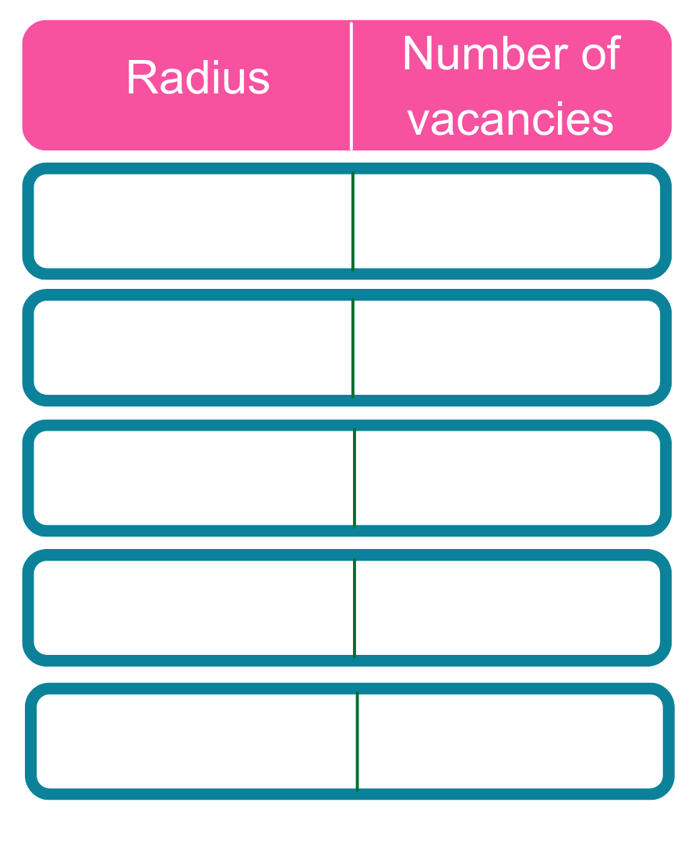
5 miles
78
10 miles
268
20 miles
532
30 miles
1,039
England
10,000
Notes:
Presenter notes: We would expect this slide to be updated by the delivery partner to reflect local opportunities by searching through Find an Apprenticeship
So as I said before, I had a look on the Find an apprenticeship website before coming along today so that I could see how many vacancies are out there at the moment.
If you notice, within 5 miles of this school/college today, there are xx vacancies.
You can see how this number grows the more you increase the distance.
You will need to think about how far you are prepared to travel for work each day.
If you want to think about working in the (insert name of an appropriate town/city), then you could be looking for vacancies there.
The one rule is that you will need to be able to get there, on time, every day.
Remember, it is important not to restrict your searches for vacancies to just look at large companies as many small employers offer some excellent vacancies with great packages and career progression opportunities.
It is also important to do some wider research and look in lots of places for apprenticeships, which we will discuss more on shortly.

Slide 9


Closing date
Weekly salary
Job opportunity
Annual salary
Accounting, Elecomm Limited
23rd Sept
£278
£14,500
Digital Marketing, BLE Lighting and Power
7th Nov
£277
£14,430
Dental Nurse, Killamarsh Dental
26th Sept
£144
£7,488
Commis Chef, Bay Tree Bistro
7th Oct
£168
£8,754
Flooring, CD Carpets
30th Sept
£192 - £380
£10,004 - £19, 760
Machinist, Go Tools
29th Sept
£187
£9,754
Notes:
Presenter notes: Please update this slide with relevant examples for your audience
Search through Find an apprenticeship using the establishment postcode and find some interesting jobs.
Try to find a selection of closing dates so that you can reinforce the need to be using Find an apprenticeship regularly
Try to find a range of salaries so that you can show that there are employers who are prepared to pay more
Try to find a job title that might sound a bit confusing and then explain what that role really is – make it sound exciting and explain that they should not be put off by the titles of some jobs, it’s important they read the job advert attached to it.
Think about STEM vacancies. Can these be showcased more?
This slide shows a range of vacancies that I could find.
You will notice that they all have different closing dates – this is one big difference to applying for university.
If you do see a closing date, it’s important that you don’t wait until the very end to submit your application. We are now finding from talking to employers, if they receive a huge number of applications, they may decide to close the application window early.
You will also notice the range of different salaries too – this is because employers can decide what to pay (as long as it meets the national minimum wage for apprentices of £4.81)
Presenter notes: It might be useful to have the find an apprenticeship website open to show them current examples and what the site looks like. This is also relevant for the next slide.

Slide 10
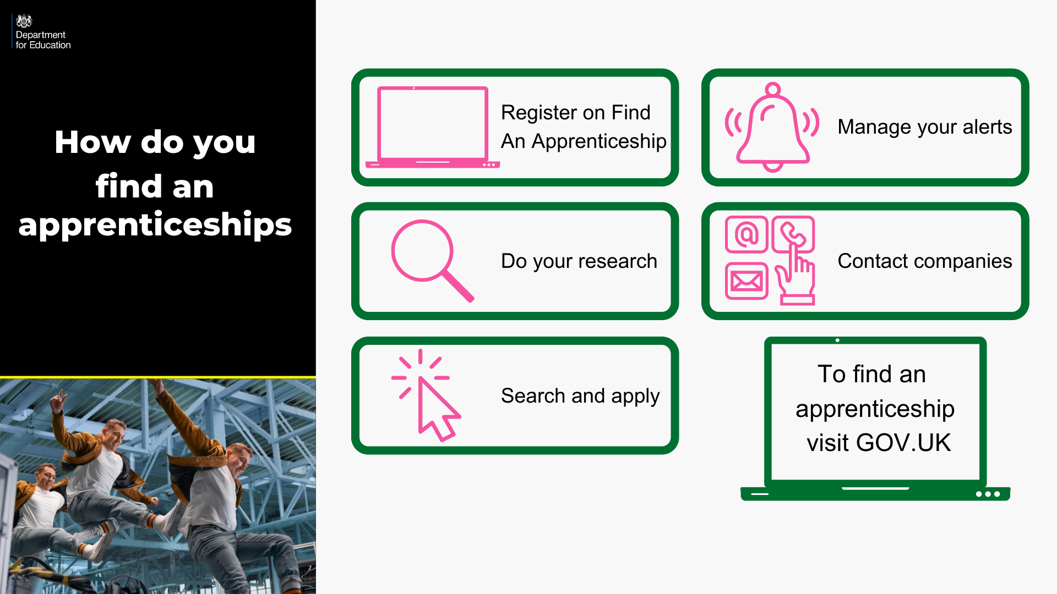
Notes:
Where did I find these vacancies? So one of the first places to look is Find an apprenticeship, the government portal for apprenticeship jobs.
1. It’s really important that you register. Search the internet for ‘Find an apprenticeship’ and it will come up as the first link The search page is on gov.uk, an official government site. Once you register you’ll receive an account activation code by email. After activating your account, you’re ready to start applying for apprenticeship vacancies.
2. Have a look at the different jobs that are being advertised. Remember, this is a live jobs site so it may be that you need to try and few different searches or to broaden how far you are looking to find jobs that you are interested in. It also means different vacancies will come up at different times so do not be disheartened if you don’t find something straight away, you may want to look again at another time or on different jobs/employer websites.
3. Start applying for jobs that interest you. You need to remember that typically, some of the bigger companies will advertise quite early in the year (e.g. September/October) for apprentices to start the following September so please don’t leave it until the last minute or you might be disappointed to have missed a great opportunity.
Others may come up later in the year closer to the time you are looking to start your apprenticeship, so use the website to help you with the next step.
4. Set up your alerts. A great feature of this system is that you can get it to do all the hard work for you. You can manage your alert settings so that you receive text messages and emails when jobs come up that you might be interested in.
5. Employers are always telling us that the applicants that really stand out to them, are those that have made a bit of extra effort. You could consider contacting the company and asking them if they have any virtual open days coming up, or work experience or other opportunities to engage with them. That will look really impressive on your application and can give you an advantage over other applicants.

Slide 11
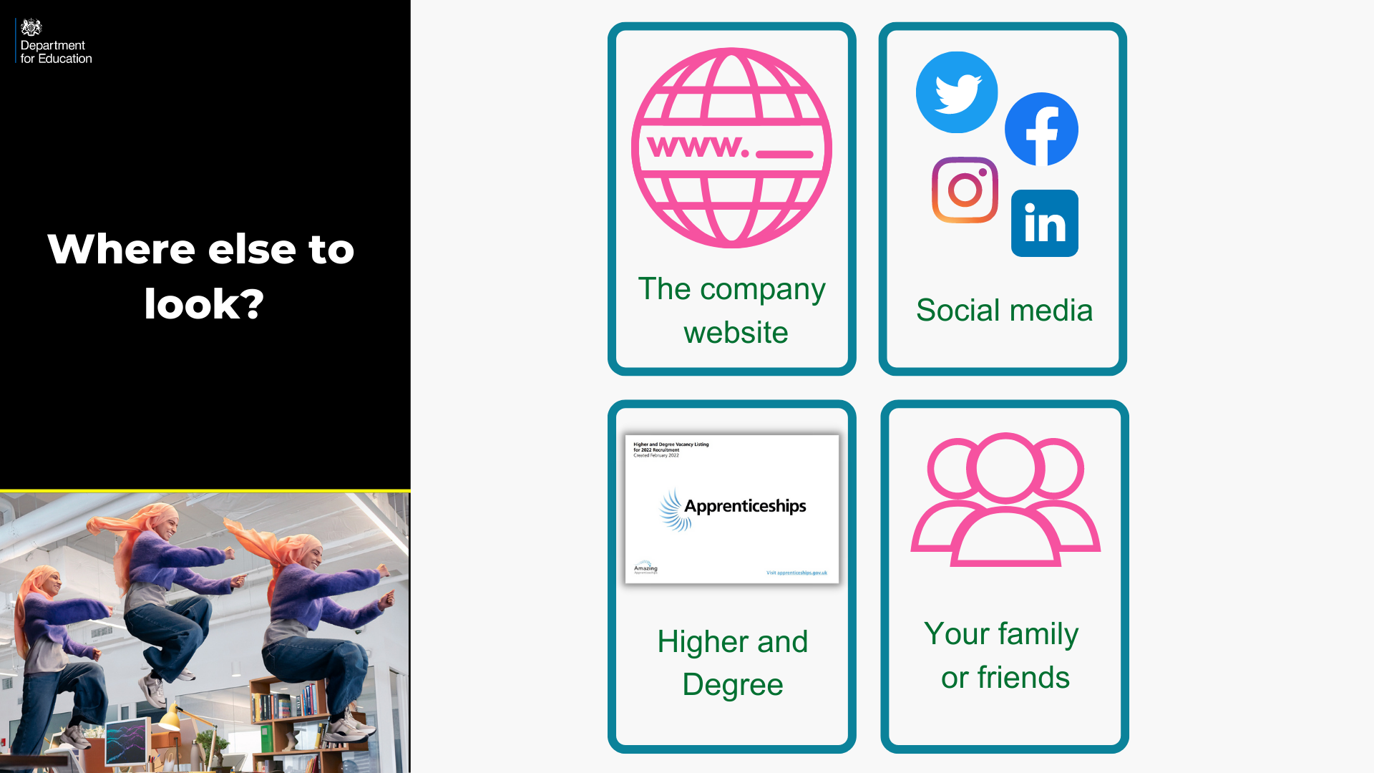
Notes:
Whilst Find an apprenticeship is a great place to start looking for apprenticeships, it is not the only place.
If you have a particular employer in mind, visit their website and see if you can sign up for recruitment alerts or if they send out a newsletter.
Make sure you follow their careers pages on social media using Facebook, Twitter and Instagram too as they will probably use this as a way to promote their vacancies. If you have a LinkedIn profile, it is worth following organisations on there as we have heard from many apprentices more recently that they have found vacancies from employers or training providers on LinkedIn. If you don’t yet have a profile, it may be worth exploring or asking for support in creating one from your school careers adviser or a parent/carer.
We have spoken to lots of apprentices and quite often, they will say that they actually heard about their job through a family member or friend. So make sure you tell everyone you can think of that you’re looking for an apprenticeship and you never know what might come through!
There are lots of other job search sites out there where you can flick through online profiles for some of the UK’s top apprentice employers.
Definitely spend some time looking into the different types of employers. There will be a real mix from your local council who might have a jobs page for young people, through to bigger recruitment sites too.
The Higher & Degree vacancy listing is also a really useful document that is shared in November and then an updated version is released again in February. This contains a list of hundreds of higher and degree apprenticeship vacancies that are open for application, and gives key information about the employer, the apprenticeship, the salary, location and where to apply. This will be shared on the Amazing Apprenticeships website and apprenticeships.gov.uk.

Slide 12

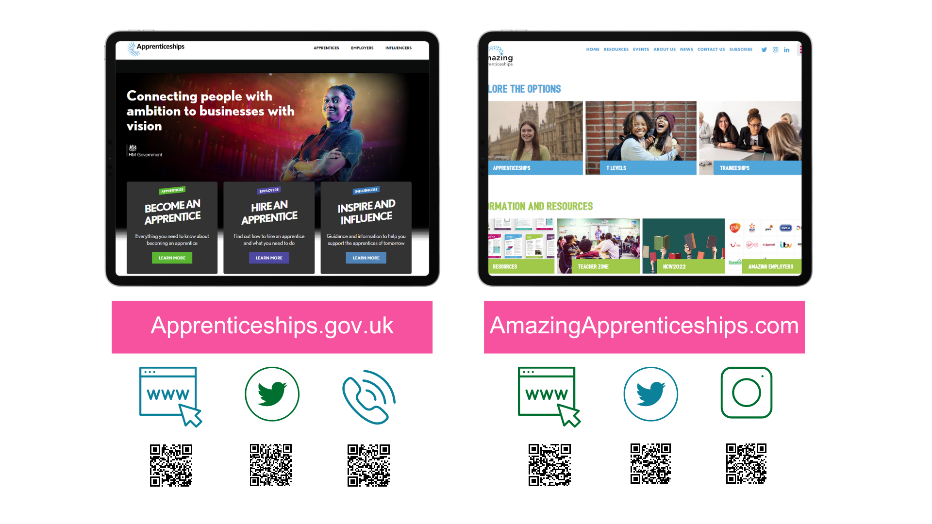
amazing
Notes:
There is lots of support and information out there to help you to stay up to date with the latest apprenticeships information.
Visit www.apprenticeships.gov.uk for more information on apprenticeships and resources to help you to search for and apply for apprenticeships.
You can also follow @apprenticeships on social media for apprenticeship updates or get in touch with the details on the slide.
To find more films, apprentice stories or learn more about apprenticeships, traineeships or T Levels, you can also go to www.amazingapprenticeships.com/student-zone.
You can also contact the National Careers Service, who as we said, can help to give you advice and guidance. Their information is on the next slide.

Slide 13

Notes:
You can visit the National Careers Service website to find out about all of the education and training options available to you once you’ve finished school.
The website gives you information about 9 different options:
3 x study options
A Levels
University (Higher Education)
Higher Technical Qualifications
2 x work options
School leaver schemes
Supported internships
4 x work and study options
Apprenticeships
Traineeships
T Levels
Vocational Technical Qualifications (VTQs)
The website helps to explain what the different options are, how they are similar/different to each other, who they are for and where to find out more information
You can find the website through the link on the slide or by scanning the QR code - https://nationalcareers.service.gov.uk/explore-your-education-and-training-choices
On the website, you will also find contact details for how to get in touch with their advisers through the helpline.

